Slide 1
About AQ
Services | Wellness | Education
AAQ-Q-06 Revision: 1 27/10/2023

Slide 2
2
AAQ-Q-06 Revision: 1 27/10/2023

Slide 3
Empowering Independence & Wellbeing
Founded in 1983, AQ is Australia’s largest dementia association that also caters to any older Australians requiring loving care and support
Our focus is on protecting older Australians’ social image and defending their competencies
Our services are delivered by more than 500 allied health professionals, clinical, expert lifestyle, community respite, hospitality, and domestic personnel
As an inclusive organisation, we strive to promote meaningful lives, by tailoring a person’s living arrangement and lifestyle to best meet their, or their loved one’s needs.
3
AAQ-Q-06 Revision: 1 27/10/2023
Notes:
AQ’s services are delivered to ensure that the dignity of Older Australians, including people diagnosed with dementia is respected at all times, and that their independence and abilities are supported.

Slide 4
Multi Service Centres
4
AAQ-Q-06 Revision: 1 27/10/2023

Slide 5
Embracing Quality of Life by Providing
Residences
Community respite (in-home and centre-based care)
Home care packages
Specialist dementia care services
Education and training
24/7 dementia helpline operated by healthcare professionals
Allied health services, including physiotherapy, exercise physiology, occupational therapy, speech pathology and wellness programs.
5
AAQ-Q-06 Revision: 1 27/10/2023

Slide 6
6
AAQ-Q-06 Revision: 1 27/10/2023

Slide 7
Community Support Services
We work with our clients to enable them to pursue pleasurable, active, and independent lives with our various Community Support Services
Our services provide a restorative and wellness approach to supporting older people, to enable them to remain engaged within their communities
We also offer customised services to those with early onset dementia, and progressive neurological conditions, focusing on optimising the individual’s quality of life.
7
AAQ-Q-06 Revision: 1 27/10/2023

Slide 8
8
AAQ-Q-06 Revision: 1 27/10/2023

Slide 9
Community Support Services (continued)
Our services aim to support each one of our clients to build relationships, pursue their interests and hobbies, and maintain independence, while simultaneously providing their carers or loved ones with a temporary break from their caring role
We offer flexible options whereby we deliver services within the comfort of our residences or Multi Service Centres
We are approved to deliver government funded programs, as well as privately funded services.
9
AAQ-Q-06 Revision: 1 27/10/2023
Notes:
For example, Cognitive Stimulation Therapy, GLAD Therapy, Music Therapy, Falls Prevention Therapy

Slide 10
10
AAQ-Q-06 Revision: 1 27/10/2023

Slide 11
Core Government Packages
Community Home Support Programme (CHSP) AQ Services
In-home respite | Individual social support
Centre-based respite | Group social support
Overnight and emergency respite | Allied health and therapy services
Lifestyle activities | Domestic assistance *
Home maintenance *
Home Care Package (HCP) AQ Services
Clinical care services | Personal care services
Transport services | Meal preparation
Medication support | Domestic assistance
Allied health and therapy services | In-home and Centre-based respite
Social support | Overnight and emergency respite
Home maintenance | Assistive technology
* Available at some AQ Multi Service Centres only
For more information about government packages call AQ or visit My Aged Care www.myagedcare.gov.au
11
AAQ-Q-06 Revision: 1 27/10/2023

Slide 12
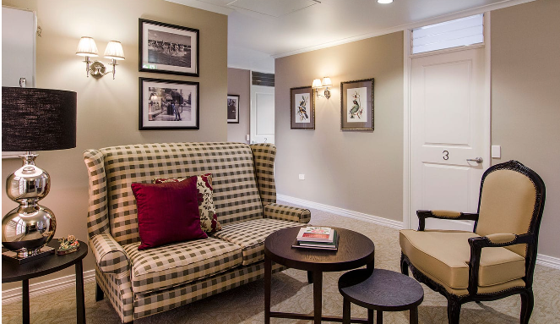
12
AAQ-Q-06 Revision: 1 27/10/2023

Slide 13
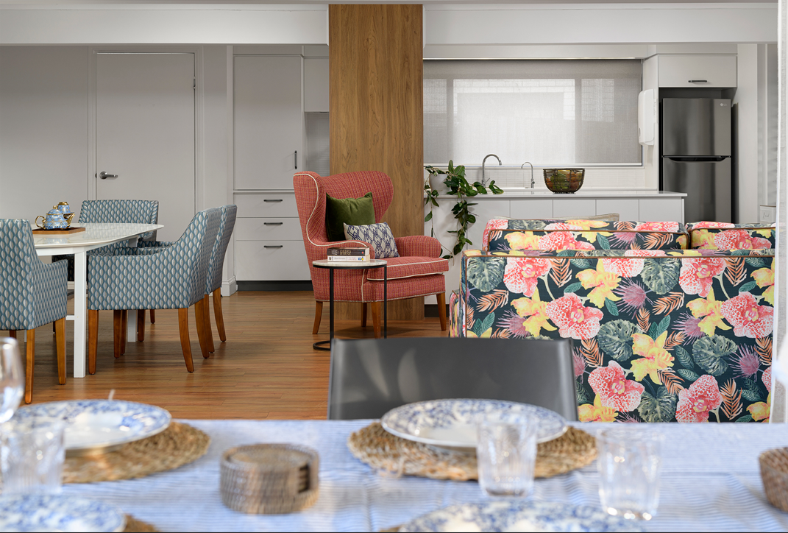
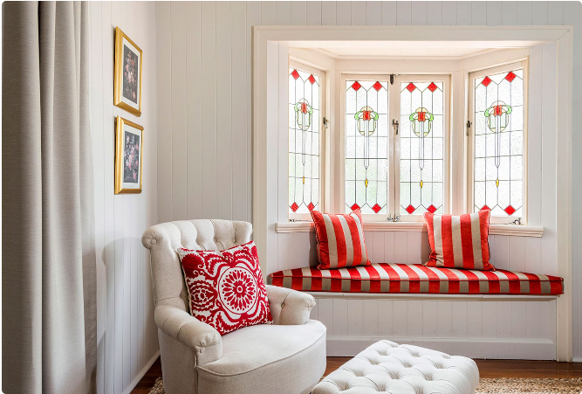
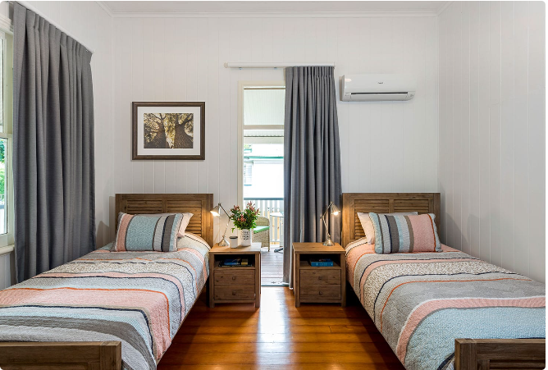
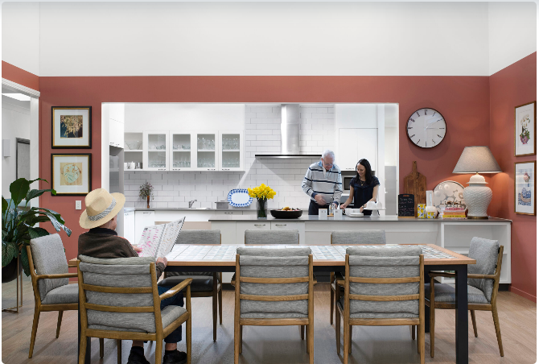
AQ Multi Service Centres
AQ Garden City Multi Service Centre
AQ Gordon Park Multi Service Centre
AQ Ipswich Multi Service Centre
AQ South Coast Multi Service Centre
AQ Toowoomba Multi Service Centre
13
AAQ-Q-06 Revision: 1 27/10/2023

Slide 14
Living Options
As we get older, changes to our lives may lead us to reassess our future and adjust our lifestyle accordingly. We may need to make decisions about where to live and the type of care we require
For some, a helping hand may be too far away. For others, the demands of looking after a household may prove too challenging. For these reasons, choosing an alternative living arrangement can be a positive decision
At AQ, we offer a range of living options, and are dedicated to helping individuals find the right living arrangement that best suits their needs.
14
AAQ-Q-06 Revision: 1 27/10/2023

Slide 15
Education & Resources
15
AAQ-Q-06 Revision: 1 27/10/2023

Slide 16
Living Options (continued)
Our residences aim to optimise health and provide high quality care for older people, those approaching frailty, and people living with dementia
We are passionate about creating homes where older people feel in control, valued, connected, and independent
There are several individual residential care types available.
16
AAQ-Q-06 Revision: 1 27/10/2023

Slide 17
Education & Resources
17
AAQ-Q-06 Revision: 1 27/10/2023

Slide 18
Individual Residential Care Types
Nursing homes for dementia care | Secure living
Permanent care | Lifestyle activities
Residential respite | Wellness programs
Palliative care | Allied Health
Ageing in place | Carer support
18
AAQ-Q-06 Revision: 1 27/10/2023

Slide 19
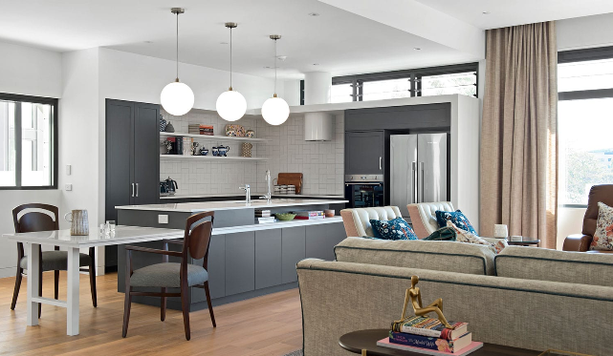
19
AAQ-Q-06 Revision: 1 27/10/2023

Slide 20
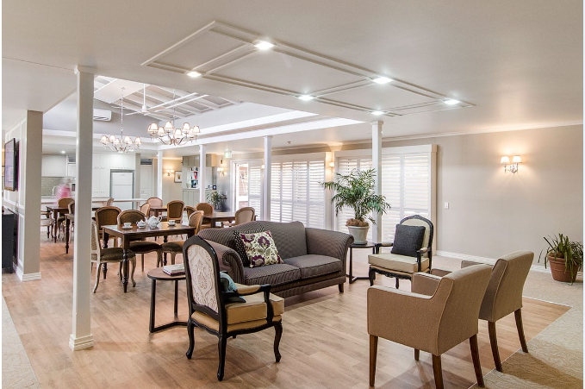
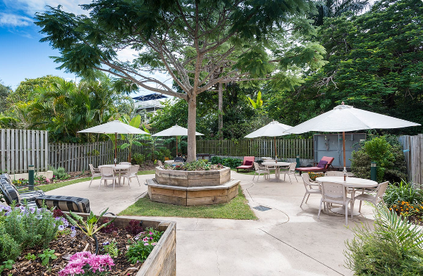
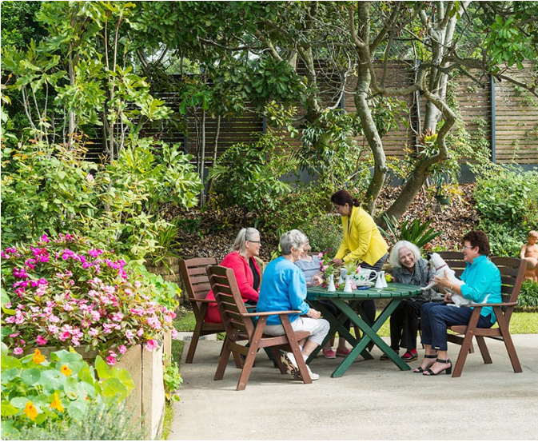
AQ Residences
AQ Garden City
Aged Care
AQ Windsor
Aged Care Services
AQ Rosalie
Nursing Care Centre
AQ McNally House
20
AAQ-Q-06 Revision: 1 27/10/2023

Slide 21
Education & Resources
We understand knowledge is a key contributor to good care and to supporting our clients and their families. AQ offers a range of dementia education and training products, not only for our clients and their families, but to our professional health workers as well.
Carer Support Groups are held at each of our Multi Service Centres to provide information and support for those caring for a friend or family member with dementia
AQ produces a quarterly newsletter, Dementia Matters, that keeps you abreast of current dementia news and our events.
21
AAQ-Q-06 Revision: 1 27/10/2023
Notes:
Our education offers practical advice on how to meet everyday needs and provide support to people with dementia so that they can maintain an independent, socially active and healthy life. In addition, AQ is a Registered Training Organisation (RTO 30213).

Slide 22
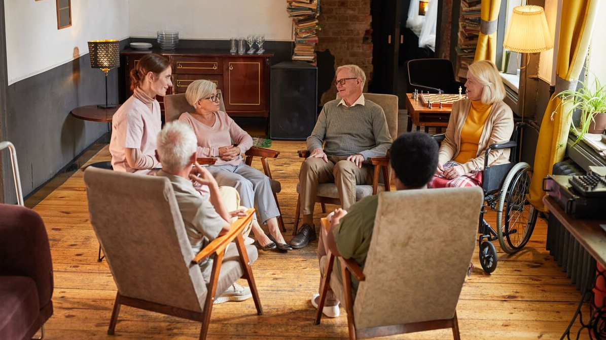
Education & Resources
22
AAQ-Q-06 Revision: 1 27/10/2023

Slide 23
Education & Resources (continued)
An accessible Resource Centre library, resourced with a range of dementia specific books, videos and journals that are regularly updated is available to the community, including people with dementia, carers, families, professionals and students
Dementia seminars and workshops, available to enhance knowledge and experience, have been designed and/or can be customised in response to identified worker needs and are suitable for all professional health workers
AQ is a Registered Training Organisation (RTO).
23
AAQ-Q-06 Revision: 1 27/10/2023

Slide 24
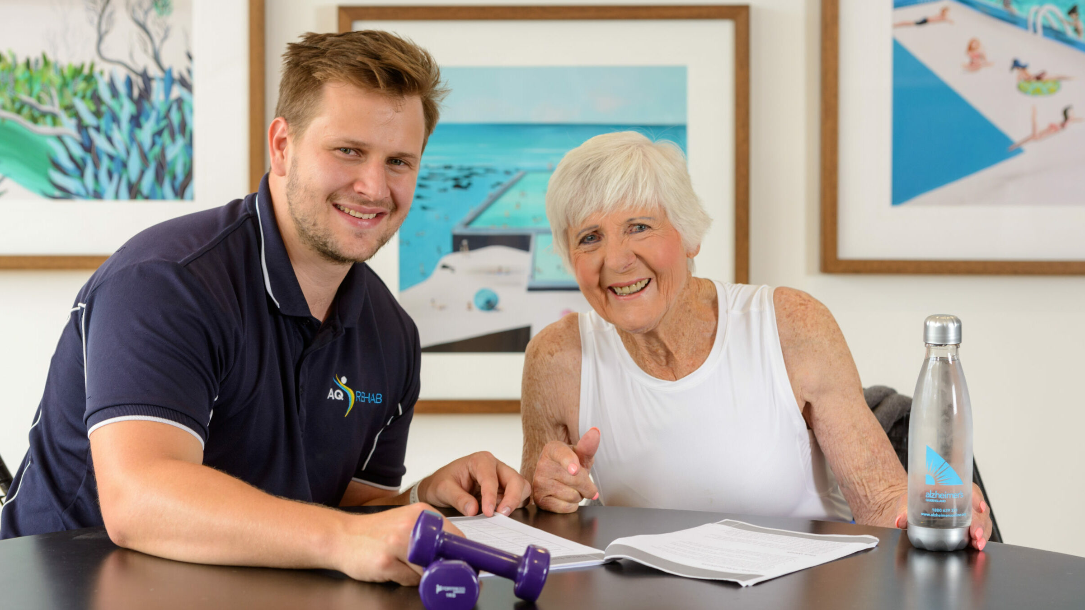
Rehabilitation & Allied Health
24
AAQ-Q-06 Revision: 1 27/10/2023

Slide 25
Qualified Health Professionals
AQ Healthy Ageing services provide practical knowledge, skills, treatment, and wellness programs to enable clients to stay active, healthy and living in their communities
Given maintaining social activity engagement is very important, our AQ Healthy Ageing services allow our clients to achieve this goal
Our flexible services are delivered by qualified health professionals either here at AQ or at our clients’ choice of location
AQ McNally House at Garden City offers state-of-the-art gym equipment and treatment rooms for both individual and group exercise sessions.
25
AAQ-Q-06 Revision: 1 27/10/2023

Slide 26
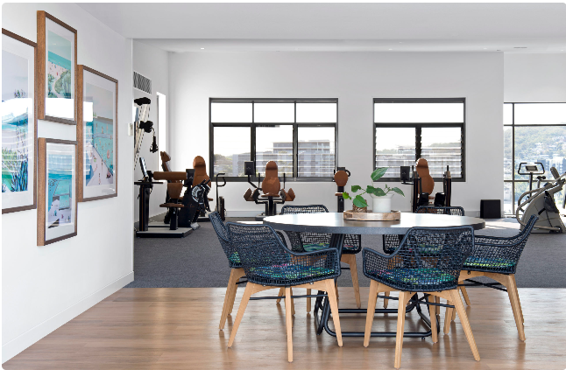
AQ Rehab & AQ Health
.
26
AAQ-Q-06 Revision: 1 27/10/2023

Slide 27
AQ Rehab & AQ Health Services
Allied health services at home * | Dietary advice and programs
Chronic disease management | Management of swallowing disorders
Cognitive Stimulation Therapy | Management of communication disorders
Music therapy | Tai chi classes
Falls prevention program | Hydrotherapy classes
Assistive aid prescriptions (i.e., walkers, wheelchairs) | Home exercise programs
Rehabilitation (post- stroke, brain injury, hospitalisation) | Dementia Telecare and Telehealth options
Memory screening and cognitive assessments | Foot care
Pain management | Home modifications
* For example, Physiotherapy, Exercise Physiology, Occupational Therapy, Speech Pathology, Dietetics and Podiatry may be available
27
AAQ-Q-06 Revision: 1 27/10/2023
Notes:
AQ has Allied Health funded through various government streams as well as private services available across all sites.

Slide 28
Rehabilitation & Allied Health
28
AAQ-Q-06 Revision: 1 27/10/2023

Slide 29
Alzheimer’s Queensland
T
07 3422 3000
F
07 3343 2557
Dementia Help Line: 1800 639 331
Education Enquiries: 1800 180 023
Service Enquiries: 1800 639 331
A
47 Tryon Street, Upper Mt Gravatt, Queensland 4122
E
enquires@alzqld.org.au
W
www.alzheimersonline.org
AAQ-Q-06 Revision: 1 27/10/2023

